Slide 1
Spring
Dependency Injection
Notes:
:D :D :D D: :D

Slide 2
Inversion of Control

Slide 3
Inversion of Control is a principle in software engineering by which the control of objects or portions of a program is transferred to a container or framework. It’s most often used in the context of object-oriented programming.
Notes:
Usually, our custom code calls a library/framework. With IoC, the framework takes control of the flow of the program and calls our custom code when we tell it to.
In IoC, if we want to add our own behaviour, we need to extend the classes of the framework or plugin our own classes.

Slide 4
Types of IoC

Slide 5
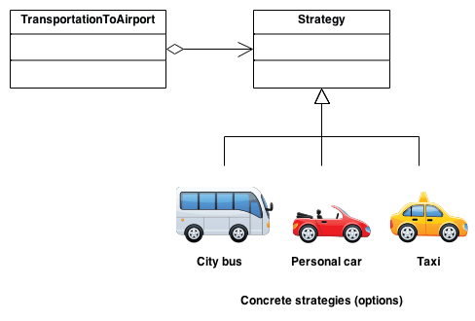
Strategy pattern

Slide 6
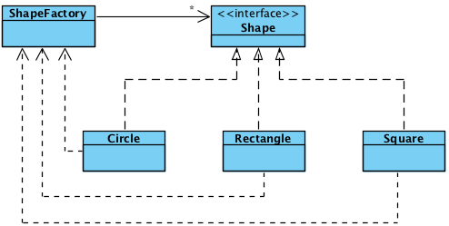
Factory pattern

Slide 7


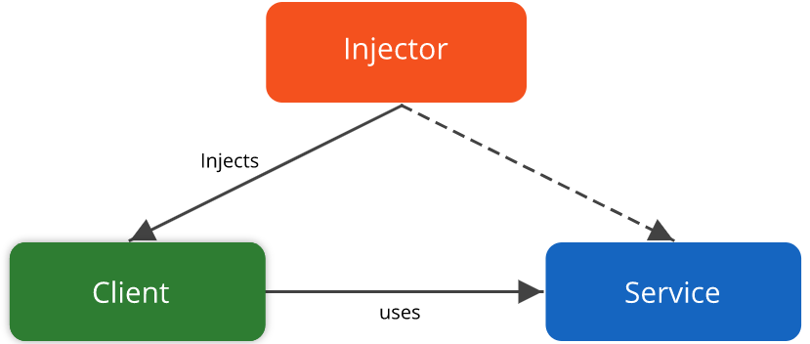
Dependency Injection

Slide 8
Advantages of IoC

Slide 9
Advantages
Decoupling execution of a task from its implementation
Easily switch between implementations
Greater modularity
Greater testability

Slide 10
Dependency injection

Slide 11
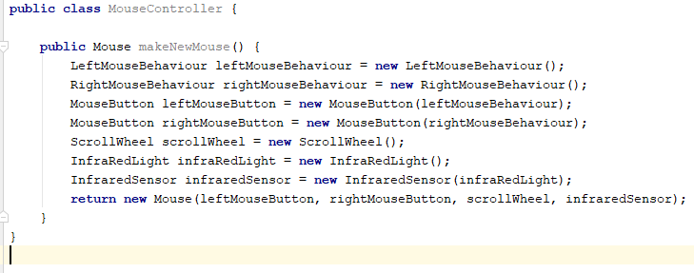
Code without Dependency Injection

Slide 12
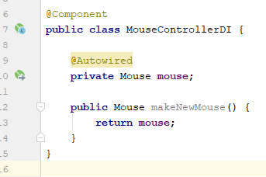
Code with Dependency Injection

Slide 13
Taking a closer look

Slide 14
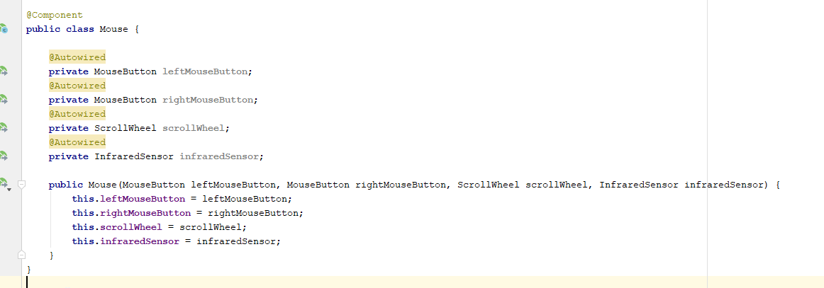
Creating a Spring Bean
Notes:
Spring ‘Bean’ orginates from Java EE’s Enterprise Java “Beans”
Also possible: javax’s @Named
Registers bean to be injected in another class.

Slide 15
Creating a Spring Bean
Alternative annotations
@Component
@Controller
@Repository
@Service
Different names for same functionality
Notes:
Also possible: javax’s @Named
Registers bean to be injected in another class.

Slide 16
Using a bean
Notes:
Also possible: javax’s @Inject
Makes Spring look up class in its registry and inject it.

Slide 17
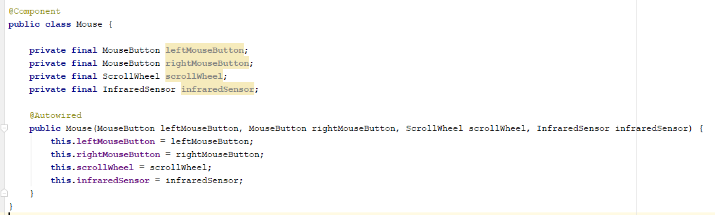
Different ways of autowiring
Notes:
Constructor autowiring (preferred way, because it makes your class’s dependencies clear)

Slide 18
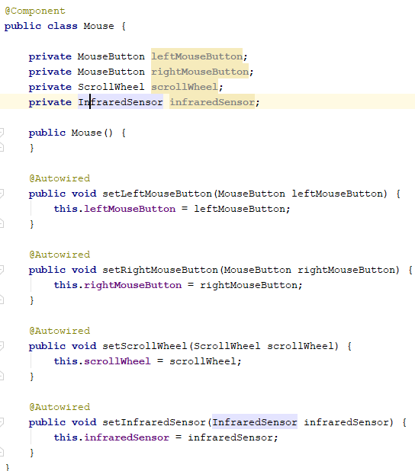
Different ways of autowiring
Notes:
Setter autowiring

Slide 19

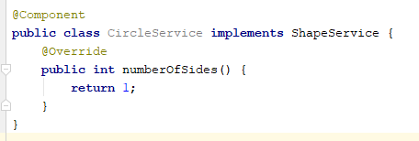
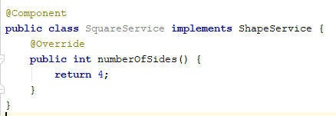
Dependency injection and inheritance

Slide 20

Dependency injection and inheritance
Problem
Notes:
Spring does not know which implementation to pick

Slide 21
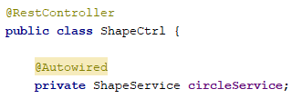
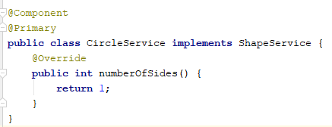
Dependency injection and inheritance
Solution 1 & 2
Notes:
Name should match class name
@Primary

Slide 22
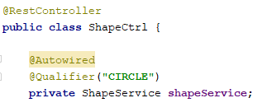
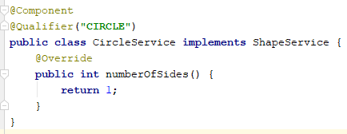
Dependency injection and inheritance
Solution 3
Notes:
Qualifier

Slide 23
Under the Spring hood
(Extremely simplified)

Slide 24
Declaring a bean
@Component
Public class ILikeSpring {}
Spring application context
“ILikeSpring” | ILikeSpring.class
“CircleService” | CircleService.class
... | ...
... | ...

Slide 25
Declaring a dependency to inject
@Component
Public class ILikeSpring {
@Autowired
Private Mouse mouse;
}
Spring application context
“Mouse” | Mouse.class
... | ...
... | ...
... | ...
Spring BeanFactory
Notes:
Recursively look up (autowired) dependencies of Mouse and resolve them too. If at a point a dependency is not found, the system crashes
All injections happen at startup time

Slide 26
Conclusions
If a class is not registered in the Spring context, you can’t inject it
Classes cannot be injected in a class that is not part of the Spring context (aka a class that has no @Component or similar annotation)
All dependencies have to be available during startup or your app won’t start
Unless they are defined as not required.

Slide 27
Turning regular classes into beans

Slide 28
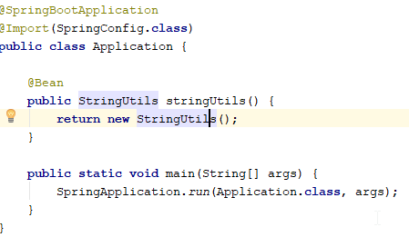
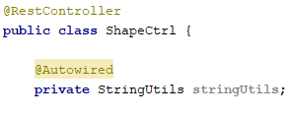
@Bean
Notes:
Handy for converting eg external library you depend on to Spring context.
@Bean should be done in classes annotated with @Configuration or in the Main class (@SpringBootApplication)

Slide 29
Scanning for beans
Notes:
Not all annotated classes are automatically added to the Spring context

Slide 30
Default scanning rules
Main class scans all annotations on its own package level and all packages below it
Non-scanned beans are not part of the Spring context, even if they have all correct annotations

Slide 31
@Configuration classes
Classes annotated with Configuration are mainly used to expand the Spring context of your application
Create new beans using @Bean
Configure Bean scanning rules using @ComponentScan
Using package names (eg: “com.cegeka.shapes”)
Using classes (eg scan everything wherever class X is located)
Should be activated using the @Import statement on the Main class
Notes:
Config + Import are handy when creating a codebase that will be used as a dependency by another codebase. They can just @Import your Configuration class and all of the beans from your codebase will instantly be available to them.

Slide 32
Bean scopes

Slide 33
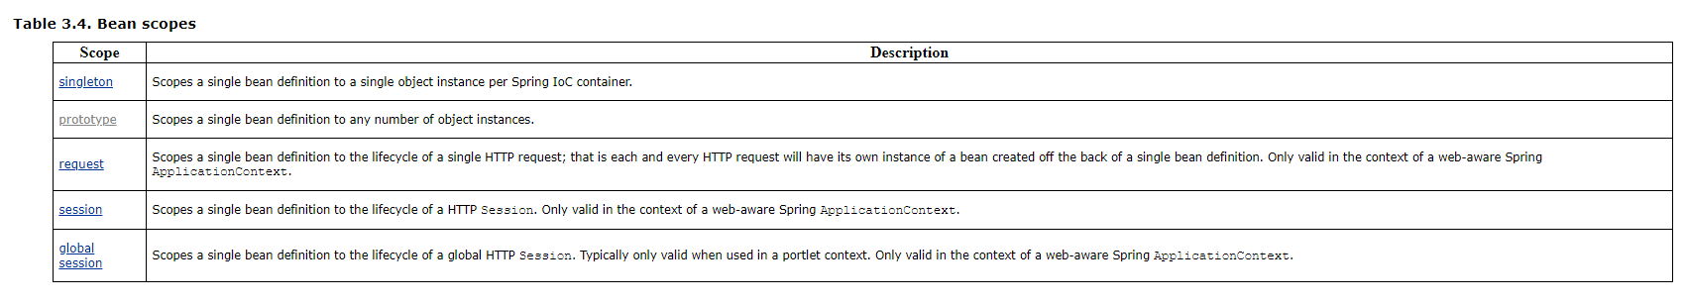
Scope overview
Notes:
Singleton is default. Rest are rarely used
Request/Session/Global Session are used in server side spring apps.Not relevant for new projects.
@Scope annotation allows you to set bean scope

Slide 34
Bean lifecycle

Slide 35
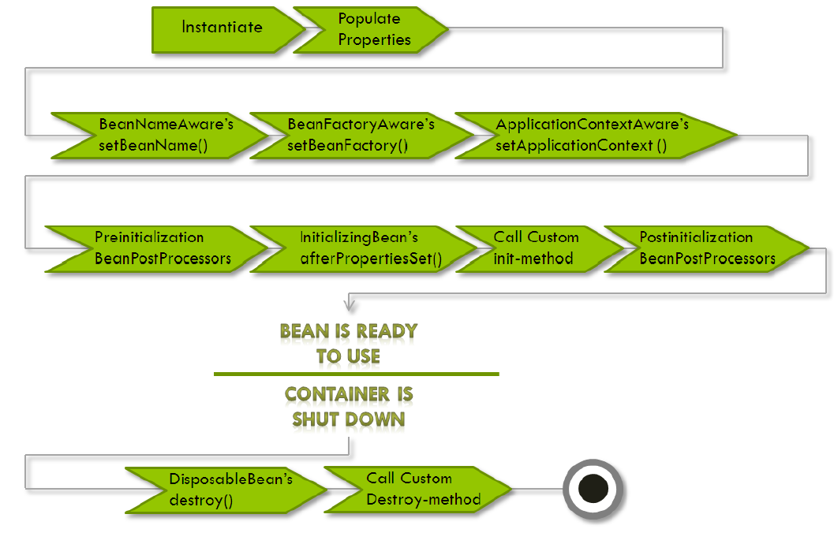
Scope overview
Notes:
@PostConstruct and @PreDestroy annotations allow you to hook into the lifecycle and do stuff during the bean’s life.

Slide 36
References

Slide 37
References
https://en.wikipedia.org/wiki/Inversion_of_control
https://www.baeldung.com/inversion-control-and-dependency-injection-in-spring
https://en.wikipedia.org/wiki/Dependency_injection
https://www.javarticles.com/2016/01/spring-componentscan-annotation-example.html
https://docs.spring.io/spring-javaconfig/docs/1.0.0.m3/reference/html/creating-bean-definitions.html
https://docs.spring.io/spring/docs/2.5.x/reference/beans.html#beans-factory-scopes-prototype
https://www.concretepage.com/spring/spring-bean-life-cycle-tutorial
https://stackoverflow.com/questions/21163355/spring-context-and-bean-lifecycle-callbacks-practical-examples-of-usage

Slide 38
Exercises

Slide 39
Exercise 1
Fork https://github.com/cegeka/Cegeka-Spring-Course
Open 01-dependency-injection in IDE
Read Exercise.md and implement solution

